Slide 1
The 71st General Service Conference of Alcoholics Anonymous
“A.A. in a Time of Change”

Slide 2
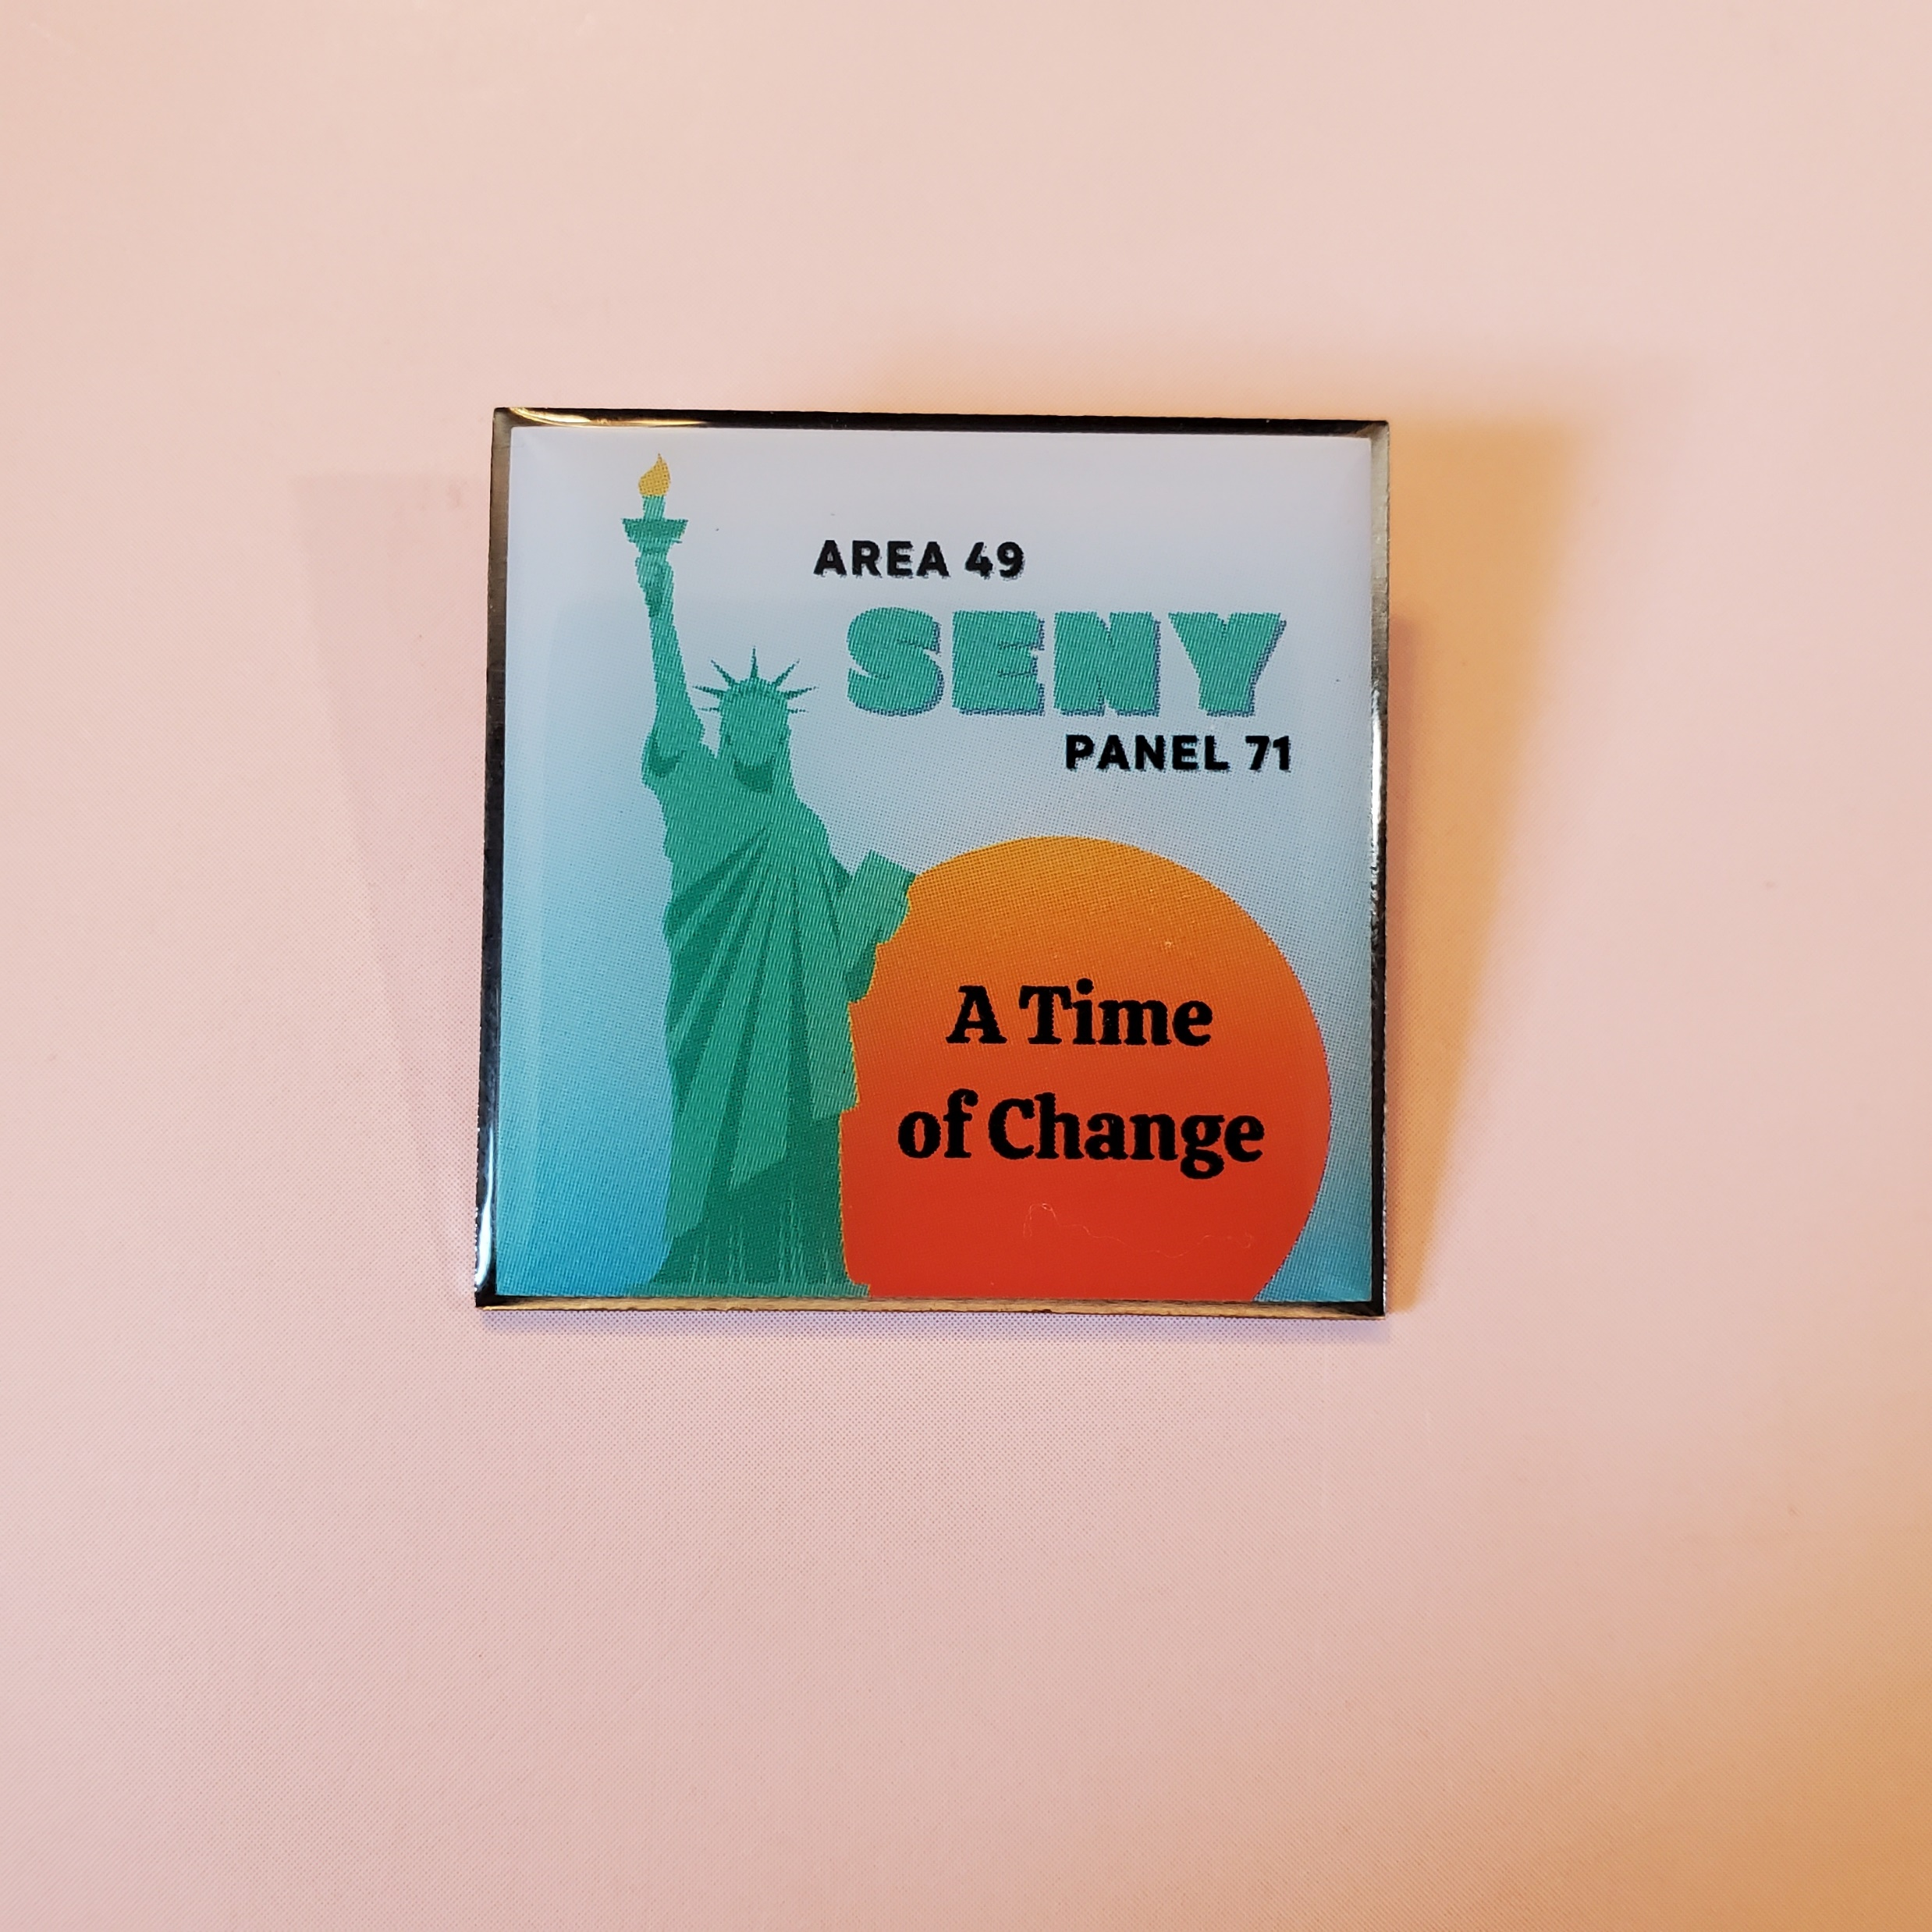
WELCOME!

Slide 3
The Business of A.A. at the General Service Conference

Slide 4
How the Conference Operates
Roberts Rules of Order (modified)
Conference Quorum
Committee System
Substantial Unanimity
Reconsideration
Tabling a Motion
Floor Actions
Motion to Recommit
Motions Made During Conference
Declining to Consider a Floor Action
General Rules of Debate and Voting
Calling the Question
Minority Opinion

Slide 5
How the Conference Operates
Committee System
“To the extent possible, important matters to come before the Conference will be handled via the ‘Committee System’… Members are encouraged to trust the process… Recommendations of Conference committees are automatically motions that have been made and seconded.”
Substantial Unanimity
“All matters of policy (Conference Advisory Actions) require substantial unanimity, that is, a two-thirds majority. Any actions, including amendments, that affect an Advisory Action, or motions that might result in such an action, also require a two-thirds majority.”
Floor Actions
“It is possible for a Conference action to come from the floor, but any matter which falls within the scope of a Conference committee ought first go through that Conference committee, so that the topic may receive due consideration.”

Slide 6
How the Conference Operates
Can the Conference Act for A.A. as a Whole?
Here is what co-founder Bill W. has to say about that in Concept III of Twelve Concepts for World Service: “Excepting for its Charter provisions to the contrary, the Conference should always be able to decide which matters it will fully dispose of on its own responsibility, and which questions it will refer to the A.A. groups (or more usually, to their Committee Members or G.S.R.s) for opinion or for definite guidance. Therefore it ought to be clearly understood and agreed that our Conference Delegates are primarily the world servants of A.A. as a whole, that only in a secondary sense do they represent their respective areas. Consequently they should, on final decisions, be entitled to cast their votes in the General Service Conference according to the best dictates of their own judgment and conscience at that time. Similarly, the Trustees of the General Service Board (operating of course within the provisions of their own Charter and Bylaws) should be able at all times to decide when they will act fully on their own responsibility and when they will ask the Conference for its guidance, its approval of a recommendation, or for its actual decision and direction. Within the scope of their defined or implied responsibilities, all Headquarters service corporations, committees, staff or executives should also be possessed of the right to decide when they will act wholly on their own and when they will refer their problems to the next higher authority.” The A.A. Service Manual, page S59, 2018-2020 Edition

Slide 7
0.757576%
How the Conference Operates
Area Delegates, U.S. and Canada 93 70.5%
General Service Board Trustees 21 15.9%
Directors of AAWS and GV/LV 5 3.8%
Staff: General Service & Grapevine 13 9.8%
Total Conference Members, 71st GSC 132 100.0%
Each Conference Member’s vote (this year) = roughly ¾ of 1% of the total vote

Slide 8
Alcoholics Anonymous has a new U.S. Trustee-at-Large
With many thanks and much gratitude to Colleen V from Brooklyn, who made herself available as Area 49’s candidate for the position.
11 of the 18 Areas of the Northeast Region put forth candidates, and after several rounds of voting, Ken T of Eastern Massachusetts was elected to represent our Northeast Region.
Each of the 6 U.S. Regions caucused for candidates in the same fashion, and after several votes (consisting of the 79 U.S. Delegates and 8 Trustees serving on the Nominating Committee), we had a new trusted servant:
Our new U.S. Trustee-at-Large is Marita H-R, from Area 42, Nevada

Slide 9
Alcoholics Anonymous World Services also has a new slate of Non-Trustee Directors, including:
Our very own John W. (II), Area 49 Delegate, Panel 67
Woo-hoo!!!

Slide 10
My Conference Committee – Cooperation with the Professional Community
We put forth 3 recommendations, that:
A dynamic LinkedIn page be implemented, with current and relevant content for professionals, to be brought back to the 2022 Conference Committee;
A pamphlet be created, directed to mental health professionals, to be brought back to the 2022 Conference Committee on C.P.C.; and
The updated pamphlet “Members of the Clergy Ask About Alcoholics Anonymous, and that it be retitled “Faith Leaders Ask About Alcoholics Anonymous”.
All three were approved as Advisory Actions by the Conference.
Additionally, our committee stressed the importance of moving forward digitally, including: a digital version of the C.P.C. Kit accessible on all platforms; full use of QR codes on all service literature; development of a virtual C.P.C. exhibit; and language in service material that is relevant and current for today’s professionals.
And I will have the privilege of chairing next year’s C.P.C. Conference Committee.

Slide 11
This year’s Delegate’s Questionnaire – The results at the 71st GSC – Literature
Consider revising the pamphlet “The A.A. Group”, to reflect the importance of the group as a “spiritual entity…”
Your Questionnaires: pretty evenly split
The Conference Committee: Considered the item, and requested it be forwarded to the 2022 Conference Committee on Literature for consideration.
Review draft language regarding safety and A.A. to be included in “Living Sober” and the pamphlet “Questions and Answers on Sponsorship”
Your Questionnaires: somewhat in favor
The Conference Committee: Considered the item, and requested it be forwarded to the 2022 Conference Committee on Literature for consideration. The committee also noted that additional consideration of the accessibility of the language is needed.

Slide 12
This year’s Delegate’s Questionnaire – The results at the 71st GSC – C.P.C. & Corrections
Cooperation with the Professional Community: Consider a request to create a pamphlet for mental health professionals
Your Questionnaires: heavily in favor
The Conference Committee: Recommended unanimously.
The General Service Conference: approved as an Advisory Action (after a VERY long discussion on the floor).
Corrections: Discuss innovative ways of carrying the message to alcoholics in correctional facilities / programs
Your Questionnaires: heavily supportive, with ideas mainly centered on the use of communication technology
The Conference Committee: based on their Committee consideration, they were thinking along the same lines and approaches as SENY. No action taken, as this was to develop future outreach strategies.

Slide 13
This year’s Delegate’s Questionnaire – The results at the 71st GSC – Grapevine/La Vina and Public Information
GV/LV: Review progress report on the development of an Instagram account
Your Questionnaires: generally opposed, re concerns of promotion / anonimity
The Conference Committee: Recommended.
The General Service Conference: approved as an Advisory Action.
Note: after hearing additional information during discussion on the floor, your Delegate voted in favor of this item, considering informing vs. promotion, and the respect of GSO/GV for anonymity on the production side.
Public Information: Produce and develop podcasts (G.S.O., in cooperation with Grapevine/La Vina)
Your Questionnaires: largely in favor
The Conference Committee: Recommended.
The General Service Conference: approved as an Advisory Action.

Slide 14
This year’s Delegate’s Questionnaire – The results at the 71st GSC – Finance & Policy/Admissions
Finance: reconsider the 1972 G.S.C. Advisory Action stating “G.S.O. should not accept contributions from clubs, listed or known as such, whether or not composed solely of A.A. members…
Your Questionnaires: largely opposed, citing Tradition 7
The Conference Committee: took no action, noting that practices regarding clubs varied throughout the Fellowship, and that there was no widely expressed need to reconsider or change the 1972 Advisory Action.
Policy / Admissions: Consider requests regarding the participation of online groups in the (U.S. & Canada) General Service Structure
Your Questionnaires: heavily in favor
The Conference Committee: Recommended, on the geographic Area / District model (vs. a Virtual Area model).
The General Service Conference: approved as an Advisory Action.

Slide 15
Advisory Actions re the “Big Book”
Development of a Fifth Edition of “Alcoholics Anonymous” has been approved, with new stories reflecting current A.A. membership (with the first 164 pages, etc. left as is).
Development of a Fourth Edition of “Alcoholicos Anonimos” has been approved, with new stories… (Do you hear that, Companeros y Companeras? Start writing!)
Development of a plain-language translation of the Big Book has been approved (based on the Fourth Edition).

Slide 16
Advisory Actions – Additional Highlights
The A.A. Service Manual has been thoroughly overhauled and made more “user-friendly” - it’s wonderful! (Look for release later this year, probably late in the fall).
The theme for the 2022 General Service Conference will be: “A.A. Comes of Age 2.0: Unified in Love and Service.”
A watermark with the word “SAMPLE” will be added to the 2nd and 3rd pie charts on page 13 of the pamphlet, “Self-Support: Where Money and Spirituality Mix.”
Twelve Steps and Twelve Traditions: the long form of each Tradition will be placed at the end of each related entry, and left intact in the back of the book as well.
The Equitable Distribution of Workload Process, as detailed in the Report from the 2020 trustees’ General Service Conference Committee, will be implemented for the 72nd General Service Conference on a three-year trial basis.

Slide 17
The Final Conference Report
As soon as the digital version is released, it will be posted at https://www.aaseny.org/from-the-delegate. Almost everything you’ve seen so far will be covered.
Hard copies should be available somewhere around September. I’ve ordered limited copies (in both English and Spanish) for Area 49, but there should be more than enough for each person who needs a paper copy.
The Final Conference Report – as well as the regularly-updated “Advisory Actions of the General Service Conference of Alcoholics Anonymous” – are wonderful resources, available to all A.A. members who want to know about and understand the journey of Alcoholics Anonymous. Don’t miss this opportunity to be better informed!

Slide 18
Advisory Actions – Summary
A total of 49 Advisory Actions were issued:
45 Committee Recommendations, and
4 Floor Actions.
The General Service Board approved all 49 “in their entirety”.
Committee Considerations
“Generally, the committee reaches a conclusion as a result of its deliberations, and presents a recommendation to the full Conference. On some items, the committee may choose to make no recommendation, or simply to report a suggestion or observation. The committee may also defer an item to the next year’s Conference, or seek further information from the Fellowship or the trustees before making a decision at a subsequent Conference.” The A.A. Service Manual, page S61, 2018-2020 Edition

Slide 19
Additional Information at the 71st General Service Conference

Slide 20
FINANCIAL FUN FACT: Slide 14, “From the Picnic Table
GRATITUDE: LARGEST CONTRIBUTIONS RECEIVED IN 2020
INCLUDED IN GROUP CONTRIBUTIONS AMOUNT
District 87 – Southwest Québec Canada $64,116.50
District 49 – Southeast New York $50,000.00
District 15 – South Florida/Bahamas/USVI/Antigua $46,223.23
Los Angeles Central Office $44,000.00

Slide 21
A Brief – REALLY Brief – Financial Summary
7th Tradition of Self-Support – 2020: $10.26 million set another record, up 15.8% from 2019. Our Fellowship responded!
The Reserve Fund (a.k.a. Prudent Reserve) dropped from 9.3 months of expenses at the end of 2019 to 7.9 months of expenses at the end of 2020.
LOTS more financial information:
“From the Picnic Table” – email me at delegate@aaseny.org
The Final Conference Report – coming soon!
The stark reality: Two days ago, on June 10th, Alcoholics Anonymous celebrated our 86th anniversary. We are STILL not fully self-supporting. To paraphrase many of our first sponsors: what are we willing to do?

Slide 22
Reports and Other Cool Stuff (in no particular order)
The Remote Communities Meeting
Kahoot It
An Amends that set the tone for the entire Conference
“If I were 10 times bolder…”
The U.S. Trustee at Large election process
The Delegates Only meetings
The Financial Report
The 26th World Service Meeting

Slide 23
“What I Saw and Heard and Felt”

Slide 24
The Roll Call – “Present”
The Serenity Meetings
A Special Moment in the C.P.C. Committee
The spirit in which A.A. Business is Conducted

Slide 25
Tradition 1. Our common welfare should come first; personal recovery depends upon A.A. unity.
Tradition 2. For our group purpose there is but one ultimate authority — a loving God as He may express Himself in our group conscience. Our leaders are but trusted servants; they do not govern.
Concept I. Final responsibility and ultimate authority for A.A. World Services should always reside in the collective conscience of our whole Fellowship.
Concept II. The General Service Conference of A.A. has become, for nearly every practical purpose, the active voice and the effective conscience of our whole Society in its world affairs.

Slide 26
2:15 AM, Sunday morning, April 25th
Entries in my journal
What I learned about me

Slide 27
A spiritual Journey: the A.A. Preamble

Slide 28
How the Conference Operates (my experience)
132 people, from the U.S. and Canada, all doing their best:
To serve all of A.A., its Groups, and its Members
To exercise “tolerance, responsibility, flexibility and vision”
To be willing to listen to, and honor, additional information
To strive for substantial unanimity (and, if in the minority, to respect the decision and accept the outcome)
To debate, not argue, and to seek the best solution
To act in love of Alcoholics Anonymous, and of each other

Slide 29
Tradition 10
The Short Form: Alcoholics Anonymous has no opinion on outside issues; hence the A.A. name ought never be drawn into public controversy.
The Long Form: No A.A. group or member should ever, in such a way to implicate A.A., express any opinion on outside controversial issues – particularly those of politics, alcohol reform, or sectarian religion. The Alcoholics Anonymous groups oppose no one. Concerning such matters they can express no views whatever.

Slide 30
An Advisory Action from the Literature Committee
“It was recommended that: The A.A.W.S. editorial staff continue to degenderize A.A. literature, with the exception of Bill W.’s writings, as the items are reprinted, e.g., ‘staffing the booth’ rather than ‘manning the booth,’ etc.”

Slide 31
An Advisory Action from the Literature Committee
“It was recommended that: The A.A.W.S. editorial staff continue to degenderize A.A. literature, with the exception of Bill W.’s writings, as the items are reprinted, e.g., ‘staffing the booth’ rather than ‘manning the booth,’ etc.”
From the 36th General Service Conference, April 1986.
See Advisory Actions of the General Service Conference of Alcoholics Anonymous 1951-2018, page 75

Slide 32
Grapevine / La Vina Agenda Item E –Background Material
“Review suggested gender-neutral language options for changes to the A.A. Preamble.”
Three Letters from within Area 49 (SENY): one from an individual, and two from groups
A letter from Area 13 (Washington, D.C.)
A letter from Area 27 (Louisiana)
Various documents concerning the Preamble going back to June 1947 (its first printing)
Your Delegate will be happy to email the full background on this Agenda item to any A.A. member in Area 49 – just email delegate@aaseny.org.

Slide 33
The GV/LV Committee “considered gender-neutral language options for possible changes to the A.A. Preamble and took no action. The committee felt they needed more information to make a decision”.

Slide 34
The GV/LV Committee “considered gender-neutral language options for possible changes to the A.A. Preamble and took no action. The committee felt they needed more information to make a decision”.
In How the Conference Operates, allowance is made for the possibility of a Floor Action. This may be considered undesirable in many, even most, cases (“trust the process”) – and there is an immediate opportunity for the Conference to decline to discuss it.

Slide 35
The GV/LV Committee “considered gender-neutral language options for possible changes to the A.A. Preamble and took no action. The committee felt they needed more information to make a decision”.
In How the Conference Operates, allowance is made for the possibility of a Floor Action. This may be considered undesirable in many, even most, cases (“trust the process”) – and there is an immediate opportunity for the Conference to decline to discuss it.
I guess we’re alcoholics. Four floor actions were brought forth on this item in rapid succession (two of them were nearly identical, and were combined by agreement of the two makers), and so, on the final day of the Conference (when all floor actions are debated) we had three…

Slide 36
Floor action #2 – “In Alcoholics Anonymous, we share our experience, strength and hope with each other…”
Floor action #3 – “Alcoholics Anonymous is a fellowship of people…”
Floor action #6 – That the Preamble revision replacing the words “men and women” with the word “people” be presented to the General Service Board for approval as the new revised A.A. Preamble.

Slide 37
After substantial, spirited and thoughtful debate, all three floor actions passed with substantial unanimity, becoming Advisory Actions.
On Saturday, May 1st, the General Service Board approved all 49 Advisory Actions as issued by the 71st General Service Conference, including the three Preamble floor actions.
And on May 12th, the Grapevine Board approved the new A.A. Preamble wording, changing “men and women” to “people”.
Please go to https://www.aaseny.org/from-the-delegate and view the top item, “Final Resolution of the Preamble Advisory Action”.

Slide 38
Tradition 10
The Short Form: Alcoholics Anonymous has no opinion on outside issues; hence the A.A. name ought never be drawn into public controversy.
The Long Form: No A.A. group or member should ever, in such a way to implicate A.A., express any opinion on outside controversial issues – particularly those of politics, alcohol reform, or sectarian religion. The Alcoholics Anonymous groups oppose no one. Concerning such matters they can express no views whatever.
Food for thought: is the A.A. Preamble, which applies solely to our Fellowship of Alcoholics Anonymous, and has nothing to do whatsoever with the outside world, really an “outside issue”?
With this Advisory Action, our Preamble is now fully inclusive – and from reading the essay in the “12 and 12” for Tradition 3 (“What would the Master do?”), isn’t that just what we’re supposed to be doing?
The key is willingness, and acceptance…

Slide 39
In Summary

Slide 40
Thank you, SENY, for this wonderful opportunity to serve all of you, and all of Alcoholics Anonymous, as your Panel 71 Delegate!
Tom B., your Delegate and Trusted Servant, Area 49, Panel 71
Questions? Preguntas?

