Slide 1
Service Sponsorship
Presented By:
Linda K-K, Panel 63 Delegate
lindako@aol.com
Jeff B., Panel 69 Delegate
a44p69delegate@gmail.com

Slide 2
Agenda
What is Service?
The General Service Structure & Intergroup
The Importance of Having A Service Sponsor
Pitfalls of not having one
The Role of the Service Sponsor for:
Initial Service role: GSR
Intermediate Service role: Area Chair
Advanced Service role: Delegate or below
Wrap-up
Questions and Discussions

Slide 3
What is Service?
Definition - A.A. service is anything whatever that helps us to reach a fellow sufferer
Physically it is anything from setting up the chairs before a meeting to serving AA as a Delegate to the GSC or a Trustee on the GSB.
Spiritually or emotionally it is giving back in anyway to AA lovingly, expecting nothing in return but actually getting back more than you could ever give.
Mentally when done it completes and balances the triangle we all strive to live in.
Dr. Bob explained it better than most.

Slide 4
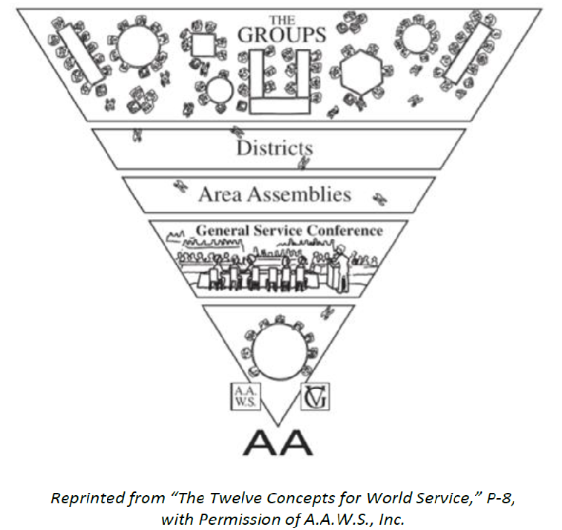
General Service Structure & Intergroup
Delegated Authority
Tradition 2 (Trusted Servants)
Two-year Rotation
A.A. belongs to the Fellowship
GSRs
DCMs
Delegates
Intergroups and Central Offices are outside the General Service structure
General Service Board
(7 Cl A, 14 Cl B)
9 Directors
9 Directors

Slide 5
Importance of Having a Service Sponsor
Recovery vs Service - It is important for the service sponsor to help individuals understand the distinction between serving the needs of the Fellowship and meeting the personal needs of another group member. It’s not all about rent, coffee and cookies.
Encouraging Getting Active - The service sponsor begins by encouraging the member to become active. First Inside the group and then outside the group.
Lead by Example - Service sponsors can impart to their sponsees the pleasure of involvement in the work of Alcoholics Anonymous. This is best done by stressing the spiritual nature of service work and by pointing out the usefulness of simple footwork and faith.
Informing and Teaching – This is done by walking the Service Sponsee through the structure and service opportunities out there waiting for them. It also involves explaining what is required to complete each opportunity so that a sponsee does not take on more than they can handle.
Pitfalls Of Not Having One – There are many and many of us have learned through our own mistakes and failures. I am no different.

Slide 6
Service Sponsor Roles
Help with current service role
Discussion of next service role
Meeting on a regular basis
Understanding the use of technology
Understanding the Inverted Triangle
Roles and duties of Group, District, Area and General Service levels
Study of Traditions & Concepts
Ability to describe GSB, Trustee Types & 2 Corporations
Knowledge of Legal structure of AA
The General Service Office and the Grapevine/La Vina
Role of the GSC & Conference charter
The role of money
Robert’s Rules of Order
Guidance
Knowledge
Spirit of rotation
Knowledge of Group con-science and trusted servants (Tradition 2)
Humility and service work
Spiritual nature of basket money
Spiritual Nature

Slide 7
Service Sponsor Roles: Initial Service Role - GSR
Help with current service role
Discussion of next service role
Meeting on a regular basis
Understanding the use of technology
Understanding the Inverted Triangle
Roles and duties of Group, District, Area and General Service levels
Study of Traditions & Concepts
Ability to describe GSB, Trustee Types & 2 Corporations
Knowledge of Legal structure of AA
The General Service Office and Grapevine/La Vina
Role of the GSC & Conference charter
The role of money
Robert’s Rules of Order
Guidance
Knowledge
Spirit of rotation
Knowledge of Group con-science and trusted servants (Tradition 2)
Humility and service work
Spiritual nature of basket money
Spiritual Nature

Slide 8
Service Sponsor Roles: Intermediate Service Role – Area Chair
Help with current service role
Discussion of next service role
Meeting on a regular basis
Understanding the use of technology
Understanding the Inverted Triangle
Roles and duties of Group, District, Area and General Service levels
Study of Traditions & Concepts
Ability to describe GSB, Trustee Types & 2 Corporations
Knowledge of Legal structure of AA
The General Service Office and Grapevine/La Vina
Role of the GSC & Conference charter
The role of money
Robert’s Rules of Order
Guidance
Knowledge
Spirit of rotation
Knowledge of Group con-science and trusted servants (Tradition 2)
Humility and service work
Spiritual nature of basket money
Spiritual Nature

Slide 9
Service Sponsor Roles: Advanced Service Role – Delegate or below
Help with current service role
Discussion of next service role
Meeting on a regular basis
Understanding the use of technology
Understanding the Inverted Triangle
Roles and duties of Group, District, Area and General Service levels
Study of Traditions & Concepts
Ability to describe GSB, Trustee Types & 2 Corporations
Knowledge of Legal structure of AA
The General Service Office and Grapevine/La Vina
Role of the GSC & Conference charter
The role of money
Robert’s Rules of Order
Guidance
Knowledge
Spirit of rotation
Knowledge of Group con-science and trusted servants (Tradition 2)
Humility and service work
Spiritual nature of basket money
Spiritual Nature

Slide 10
Wrap-up and Questions/Discussion

